Slide 1
ITS Schematic Check
7 Mar 2024
Nuvoton Technology Singapore
*Schematic and software flow discussed/stated in this document are for reference consideration only.
*Customer will need to perform detail verification and validation to ensure functionality and reliability of the design.

Slide 2
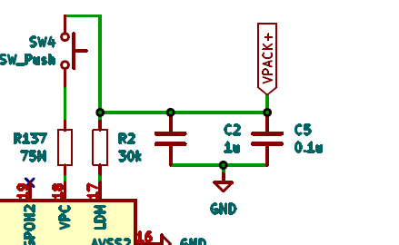
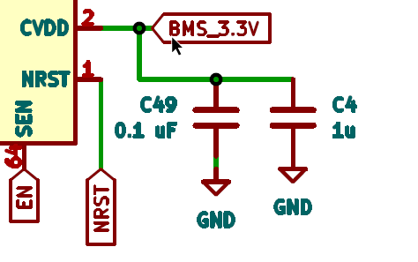
 | Items | Comment and Remarks
1 2 | BMIC Circuit - VPC CVDD | Suggest VPC connect to VBAT because VPACK is connected to charger and will not have constant input. These resistors put 0ohm first as spare for changing if needed after evaluation 0.1uF is needed. 1uF can be kept as spare first. If communication of SPI is good and CVDD supply in PCB is stable, the 1uF can be ignored
VBAT
1
1

Slide 3
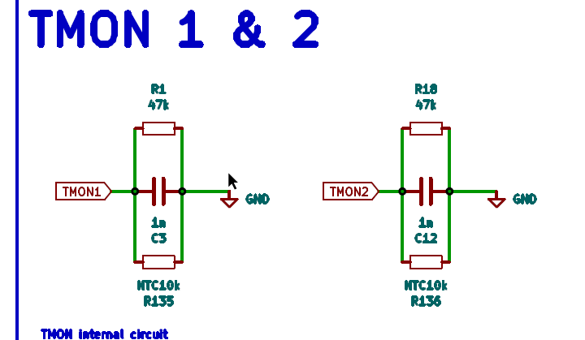
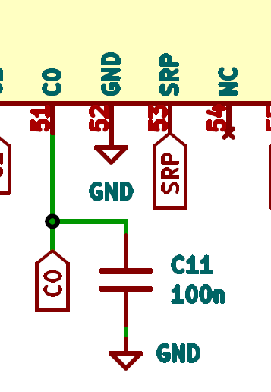
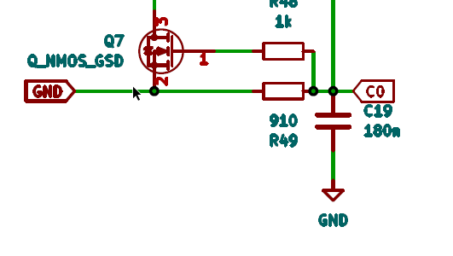
 | Items | Comment and Remarks
3 4 | TMONI C0 | Put landing pad as a spare in case low temperature sensing. What is the purpose of this capacitor, C11? There is already a similar C0 to GND capacitor, C19 added at schematic near to Cell Balance part of the schematic. (See below)
1
1

Slide 4
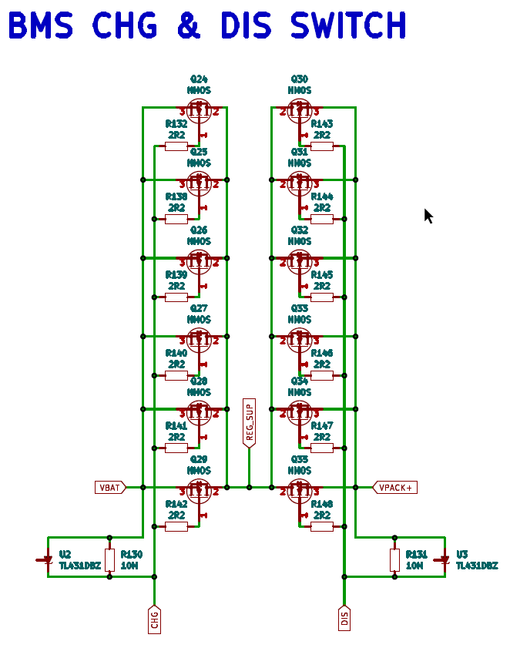
 | Items | Comment and Remarks
5 | CHG & DIS Circuit | Gate balancing resistor value should be more than 10 to around 100ohm
1
1

Slide 5
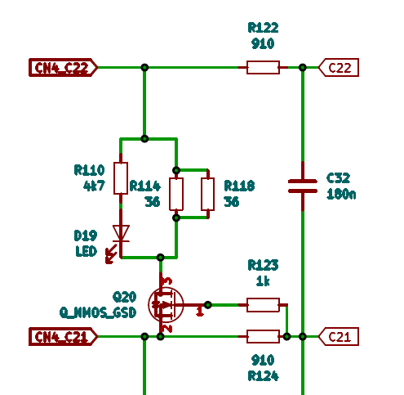
 | Items | Comment and Remarks
6 | Balancing Circuit | Suggest 1kohm at all cell pins filtering Resistor Suggest 1uF for best measurement accuracy at all Cell pins filter capacitors
1
2
1

